Slide 1
Introduction to MarkLogic 4.2
Kenneth Chestnut, Vice President of Product Marketing
October 2010

Slide 2
Agenda
Company update
Today’s information landscape
MarkLogic 4.2 overview

Slide 3
Vertical Market Strategy
Horizontal technology, vertical go-to-market
Systematic development of vertical markets
Go-to-market strategy
Product requirements
Enterprise as market exploration
Advantages
Virtuous cycle of domain expertise
Speak language of the customer
Consultative value beyond technology
Relatively homogenous requirements
Difficult to dislodge
See Geoffrey Moore: Inside the Tornado
Govt
Media
Finsvc
OEM
Enterprise

Slide 4
Leverage Valuable Information More Effectively
MarkLogic helps:
Physicians better diagnose their patients
Government agencies preserve and archive national treasures
Traditional media companies move to new media
Wall Street analyze complex derivatives positions
Soldiers share information to perform their missions more effectively

Slide 5
Today’s Information Landscape Requires A New Approach
RDBMS
MarkLogic
Information Continuum
XML
Metadata
Geospatial
Graph
Relational
Time-varying
Sparse
Emails
Documents
Free text
Hierarchical
Semi-structured
Content
Structured
Unstructured

Slide 6
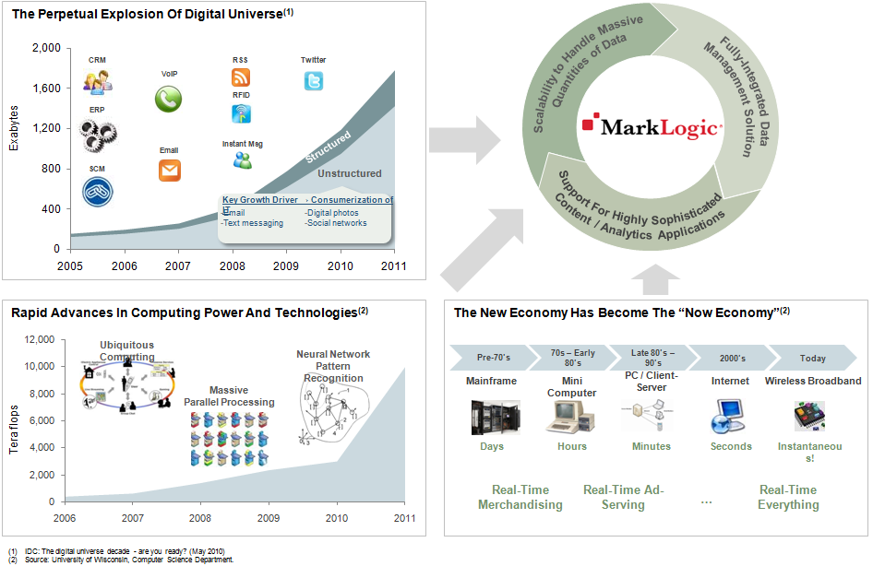
MarkLogic in Four Concepts
Unstructured
Information
Internet
Scale
Commodity
Hardware
Real-Time
Speed

Slide 7
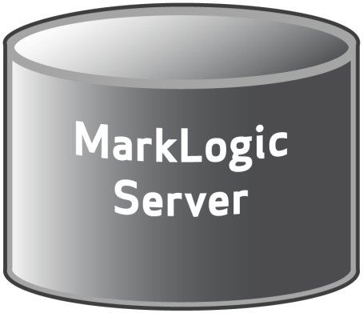
The Industry’s Leading Database for Information Applications
MarkLogic enables agility, speed and scale
Document-centric
Transactional
Search-centric
Structure-aware
Schema-agnostic
Standards-based
High performance
Clustered
Database server

Slide 8
MarkLogic 4.2 Release
MarkLogic 4.2 provides:
Agility and ease-of-use
Information Studio – new product
XSLT support
Enterprise-grade robustness
Replication
Database rollback
Failover
Compartment security
Password enforcement
Industry-leading search and discovery
Distinctive terms
Proximity boost

Slide 9
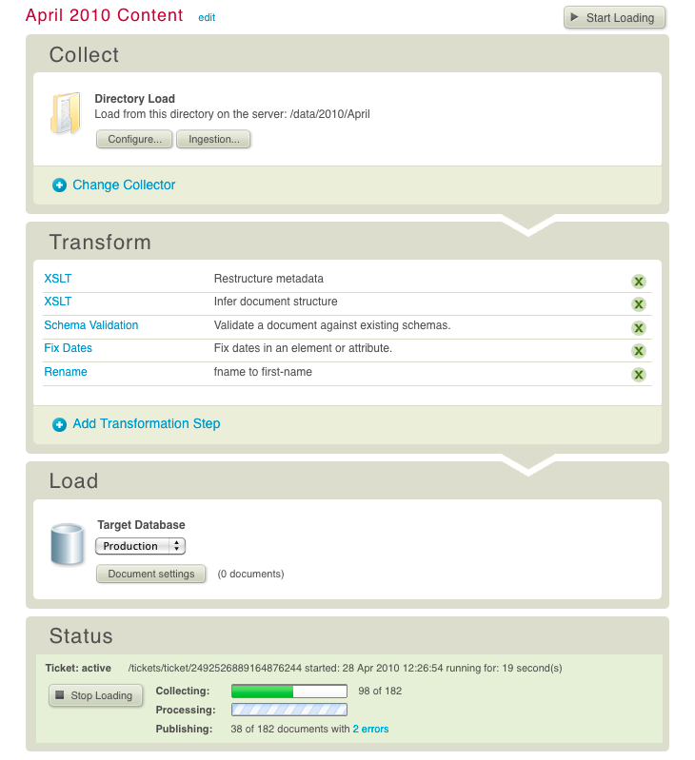
Information Studio
New product in Application Services 2.0
A browser-based tool to simplify loading content for information applications
Key points:
Simplify loading process within browser-based UI
Drag and drop files for easy loading
Improve efficiency and repeatability of information loading tasks

Slide 10
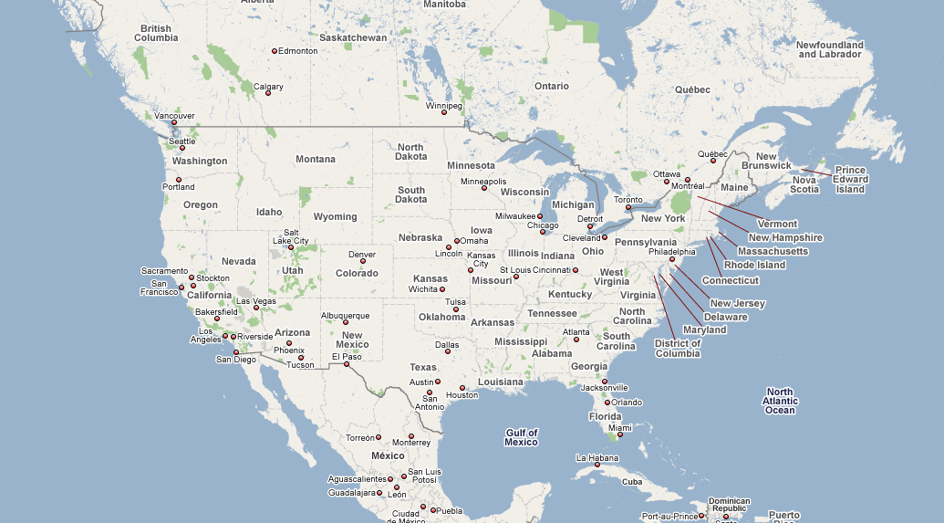
Replication
Selective replication of documents or parts of documents across databases
Transform information as it is distributed
Key points:
Implement replication as part of an enterprise-grade disaster recovery solution
Provide selective information sharing in secure or regulated environments
Geographically distribute information

Slide 11
Database Rollback: Instantaneous Point-In-Time Recovery
Reduce downtime when recovering from data corruption caused by a user or an application
Replay journals
Last
Backup
Just before
bad transaction
Recover to timestamp
Last
backup
Just before
bad transaction

Slide 12
Failover
High availability feature that automatically takes over for a failed server within a cluster
Ensure high availability of your system on various disk configurations
Lower hardware costs by using local storage instead of a clustered filesystem

Slide 13
Failover: Existing Functionality
Host ₁
Host ₂
Host ₃
Host ₄
Host ₅
Host ₆
Host _{k}
CFS
&
SAN
partition₁
partition₂
partition₃
partition₄
Notes:
Show e-nodes and d-nodes, then click and say that they’re the same binary

Slide 14
Failover: A New Option
Host ₁
Host ₂
Host ₃
Host ₄
Host ₅
Host ₆
Host _{k}
P₁
P₂
P₁
P₂
P₃
P₄
P₃
P₄
Local
Storage
Notes:
Show e-nodes and d-nodes, then click and say that they’re the same binary

Slide 15
Compartment Security
Extension of MarkLogic’s role-based security model to include compartments
Apply security models that include multiple classifications, communities of interest, access groups, and information handling caveats
Widely used in government security and information sharing situations
Example: you can read this document if you are in one of the countries this document has been released to AND assigned to one of the tasks that need to read this document AND a US citizen

Slide 16
MarkLogic Technical Indicators
Give us a call if you have one or more of the following:
Piles of unstructured information (e.g., XML)
In the terabytes to petabytes range
Projects bolting search engines to relational databases
And/or attempts to use search engine as application platform
Performance problems with unstructured data in an RDBMS
Ingestion and/or query
Desire to integrate structured and unstructured information
Need to leverage geospatial data
Teams investigating NoSQL database alternatives

Slide 17
Thank You

Slide 18
Examples of Information Applications
Common Repository
Metadata Catalog
Digital Content Delivery
Information Intelligence
Social Applications
Repurpose information trapped in existing silos
Make information more accessible and more relevant
Improve collaboration and decision-making

Slide 19
Requirements for Information Applications
Companies should be able to:
Use information “as is”
Throw away nothing
Manage big information
Support cloud-based architecture
Have real-time access to new information

